Slide 1
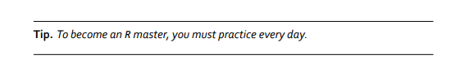
The Exciting Presentation on Data Cleaning!
Darina Chudnovskaya
Katerina Placek

Slide 2
Today on Data Cleaning in R:
Data Analysis Outline
Importing Data into R
Inspecting Data
NAs vs NaNs + Missing Data
Variable Types
Dealing with Inconsistent Data
Reshaping/Pivoting Data
Discussion Topics
References & Further Resources

Slide 3
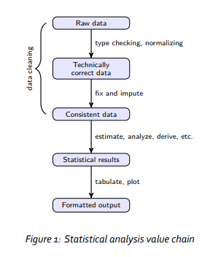
Data Cleaning: The First 3 Steps of any Analysis

Slide 4
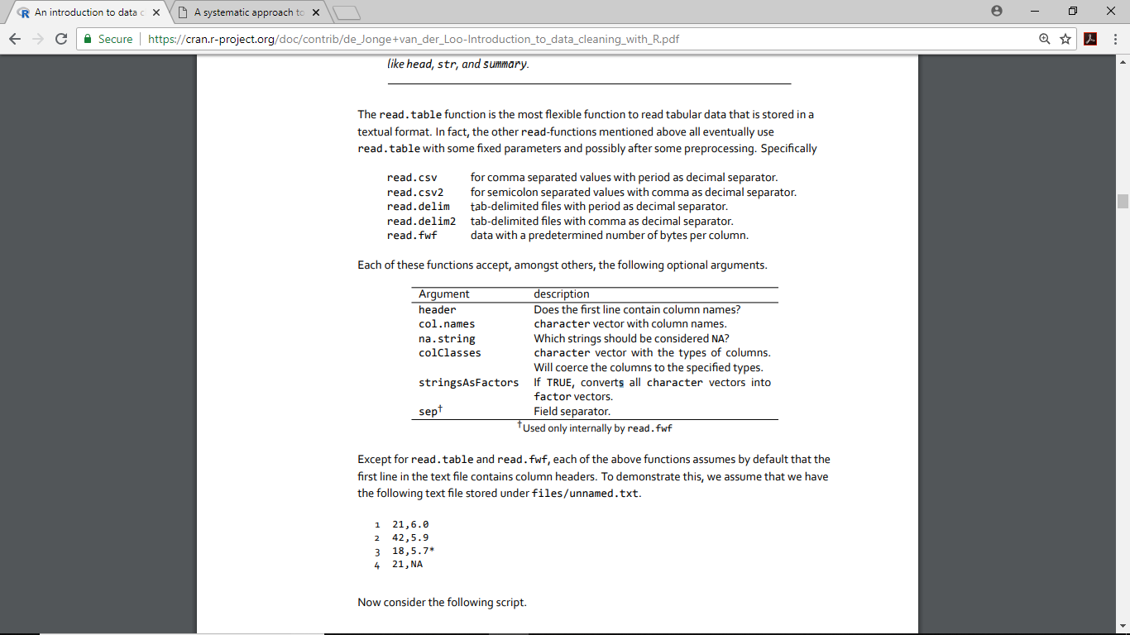
Importing Raw Data into R

Slide 5
Importing Raw Data into R

Slide 6

Importing Raw Data into R: Excel
library(readxl)
read_excel()
https://readxl.tidyverse.org/

Slide 7
Inspecting Data
Best practice. A freshly read data.frame should always be inspected with functions like head, str, and summary.
head()
View() *note the capitalization!
names()
dim()
unique()
table()
summary()

Slide 8
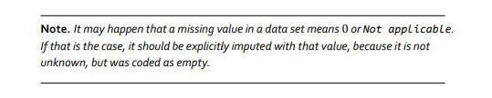
Nas vs NaNs
NA - Not Available (how R codes missing data)
NaN- Not a Number (0/0)
is.na() returns TRUE for both NA and NaN; however is.nan() returns TRUE for NaN and FALSE for NA

Slide 9

Blanks Treated as Values
dplyr
mutate_if()
Looks for factors across columns (treats blanks as factors) then replaces blanks (one or more spaces) with NAs
Base R
replace()
You can also replace NA with a different value, e.g. imputing data

Slide 10
Variable Types
Numeric Numeric data (approximations of the real numbers, ℝ)
Integer Integer data (whole numbers, ℤ)
Factor Categorical data (simple classifications, like gender)
associated with numeric values
Ordered Ordinal data (ordered classifications, like educational level)
Character Character data (strings) raw Binary data

Slide 11

Inconsistent Values
Here, we look at this in terms of string manipulation
white spaces
stringr - detect matches, subset strings, manage lengths, mutate strings, join and split, order strings
str_squish() – eliminates white space
CaPitaliZATion
Base R
grep()

Slide 12
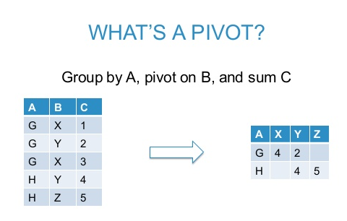
Reshaping / Pivoting Data
‘Wide’ to ‘Long’ or vice versa
‘Long’ format - multiple row per one observation
‘Wide’ format - one observation per row
Base R
reshape() Need to reshape by “id” and “time”
reshape
melt() data to tidy format (e.g. one observation per row)
cast() to shape of choice

Slide 13
Discussion Topics
Normalizing data
Working with date/time data – topic for a future meetup?
Scrapped data from web pages
Annotating video data

Slide 14
References
https://cran.r-project.org/doc/contrib/de_Jonge+van_der_Loo-Introduction_to_data_cleaning_with_R.pdf

